Slide 1
UNB MRI Centre Magnetic Field plotter & Fluid Flow with Gradient of SA3 Magnet
Devin Morin
Aug 2019

Slide 2
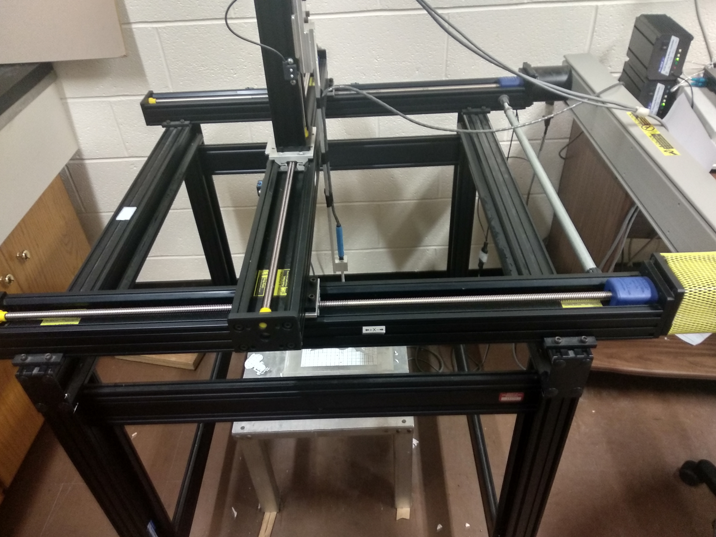
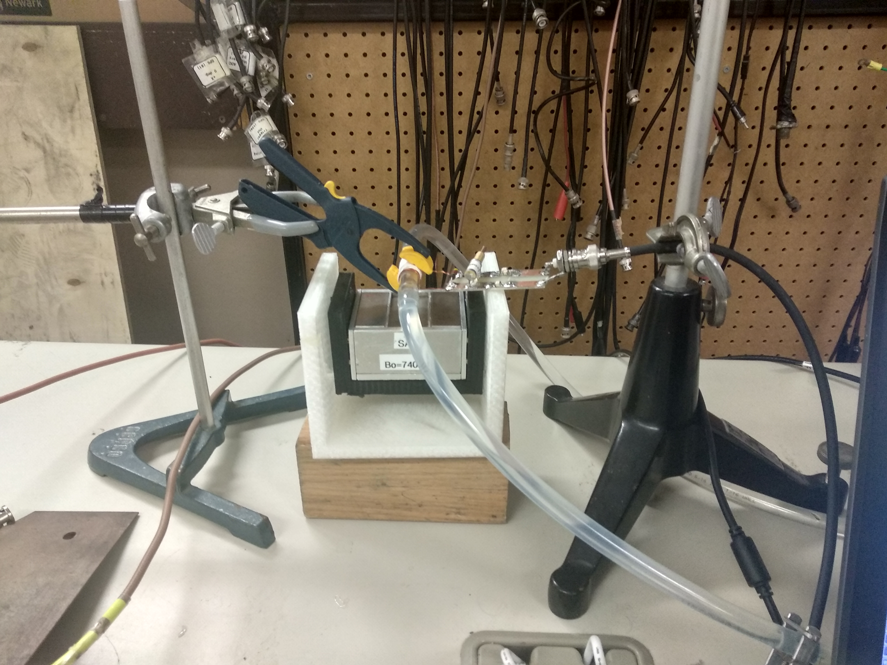
Projects
Magnetic Field Plotter
SA3 Fluid Flow Measurements

Slide 3
System parts
LakeShore 460 Gaussmeter
Velmex Stepper Motor Controllers
The MatLab script to bring it all together
Serial Port 1
LakeShore Gaussmeter
-Receives a measure code, then sends the Bx, By, Bz data
MatLab Script (MagFieldMeas.m)
Serial Port 2
Velmex Stepper Motors
Limit Switches
-Send break to motors if pressed

Slide 4
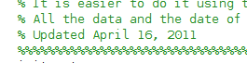
Initial Problems
Hardware problems
Recovered drives have scarce bits of code
Little documentation

Slide 5
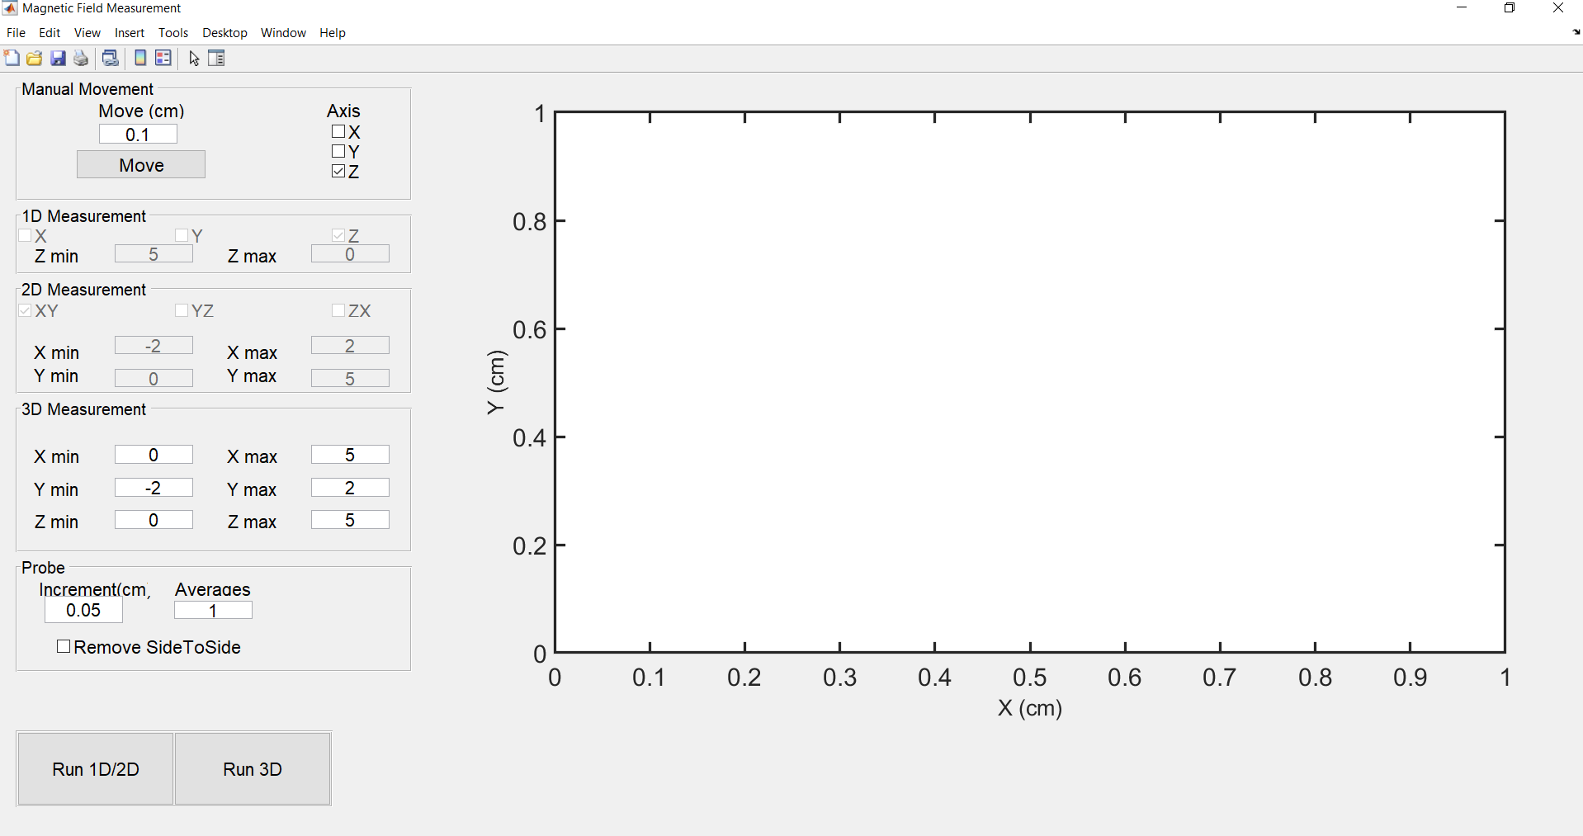
Final Design GUI

Slide 6
Handheld Unilateral Magnet Flow Design
Using SA3 with constant gradient region at some angle

Slide 7
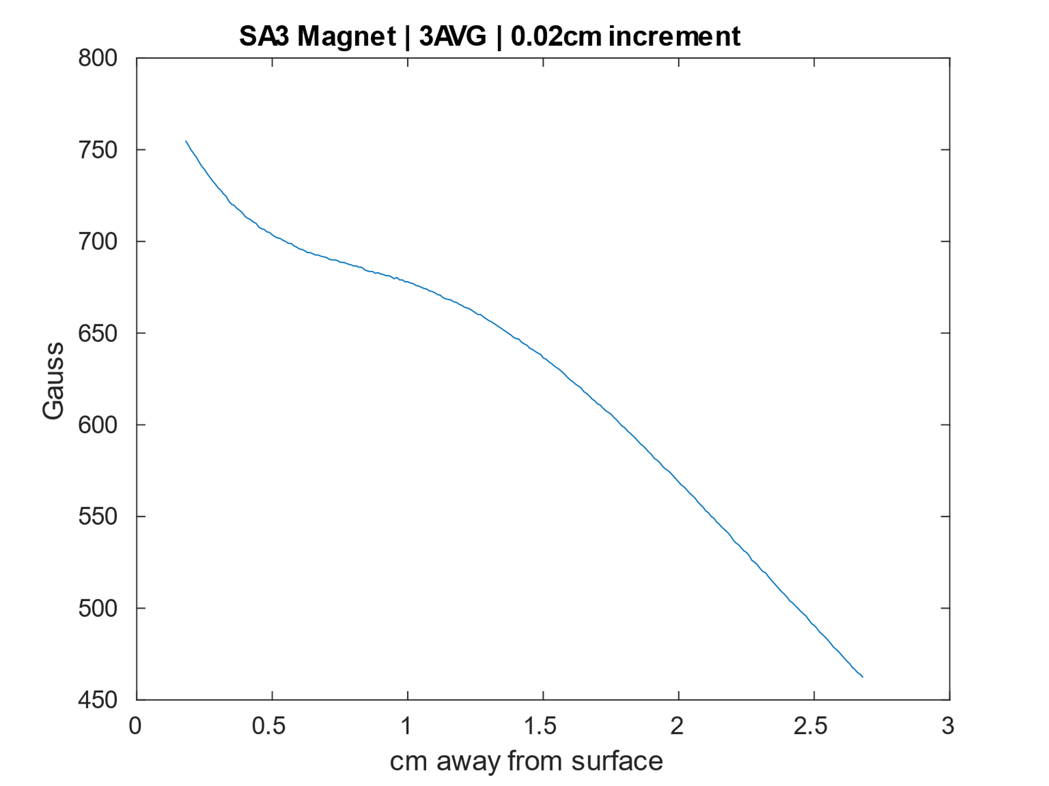
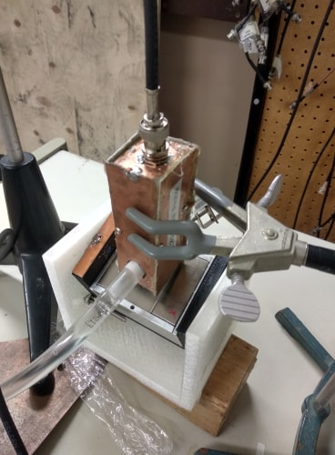
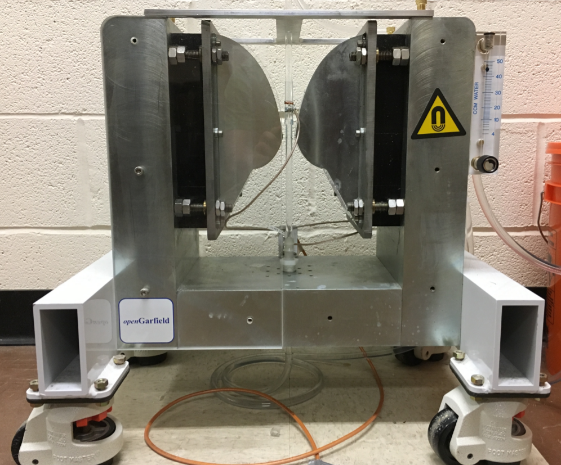
SA3 Fluid Flow Setup
Constant Gradient of 150 gauss/cm from 2.0cm to 2.5cm above surface of magnet
SA3
GARfield

Slide 8
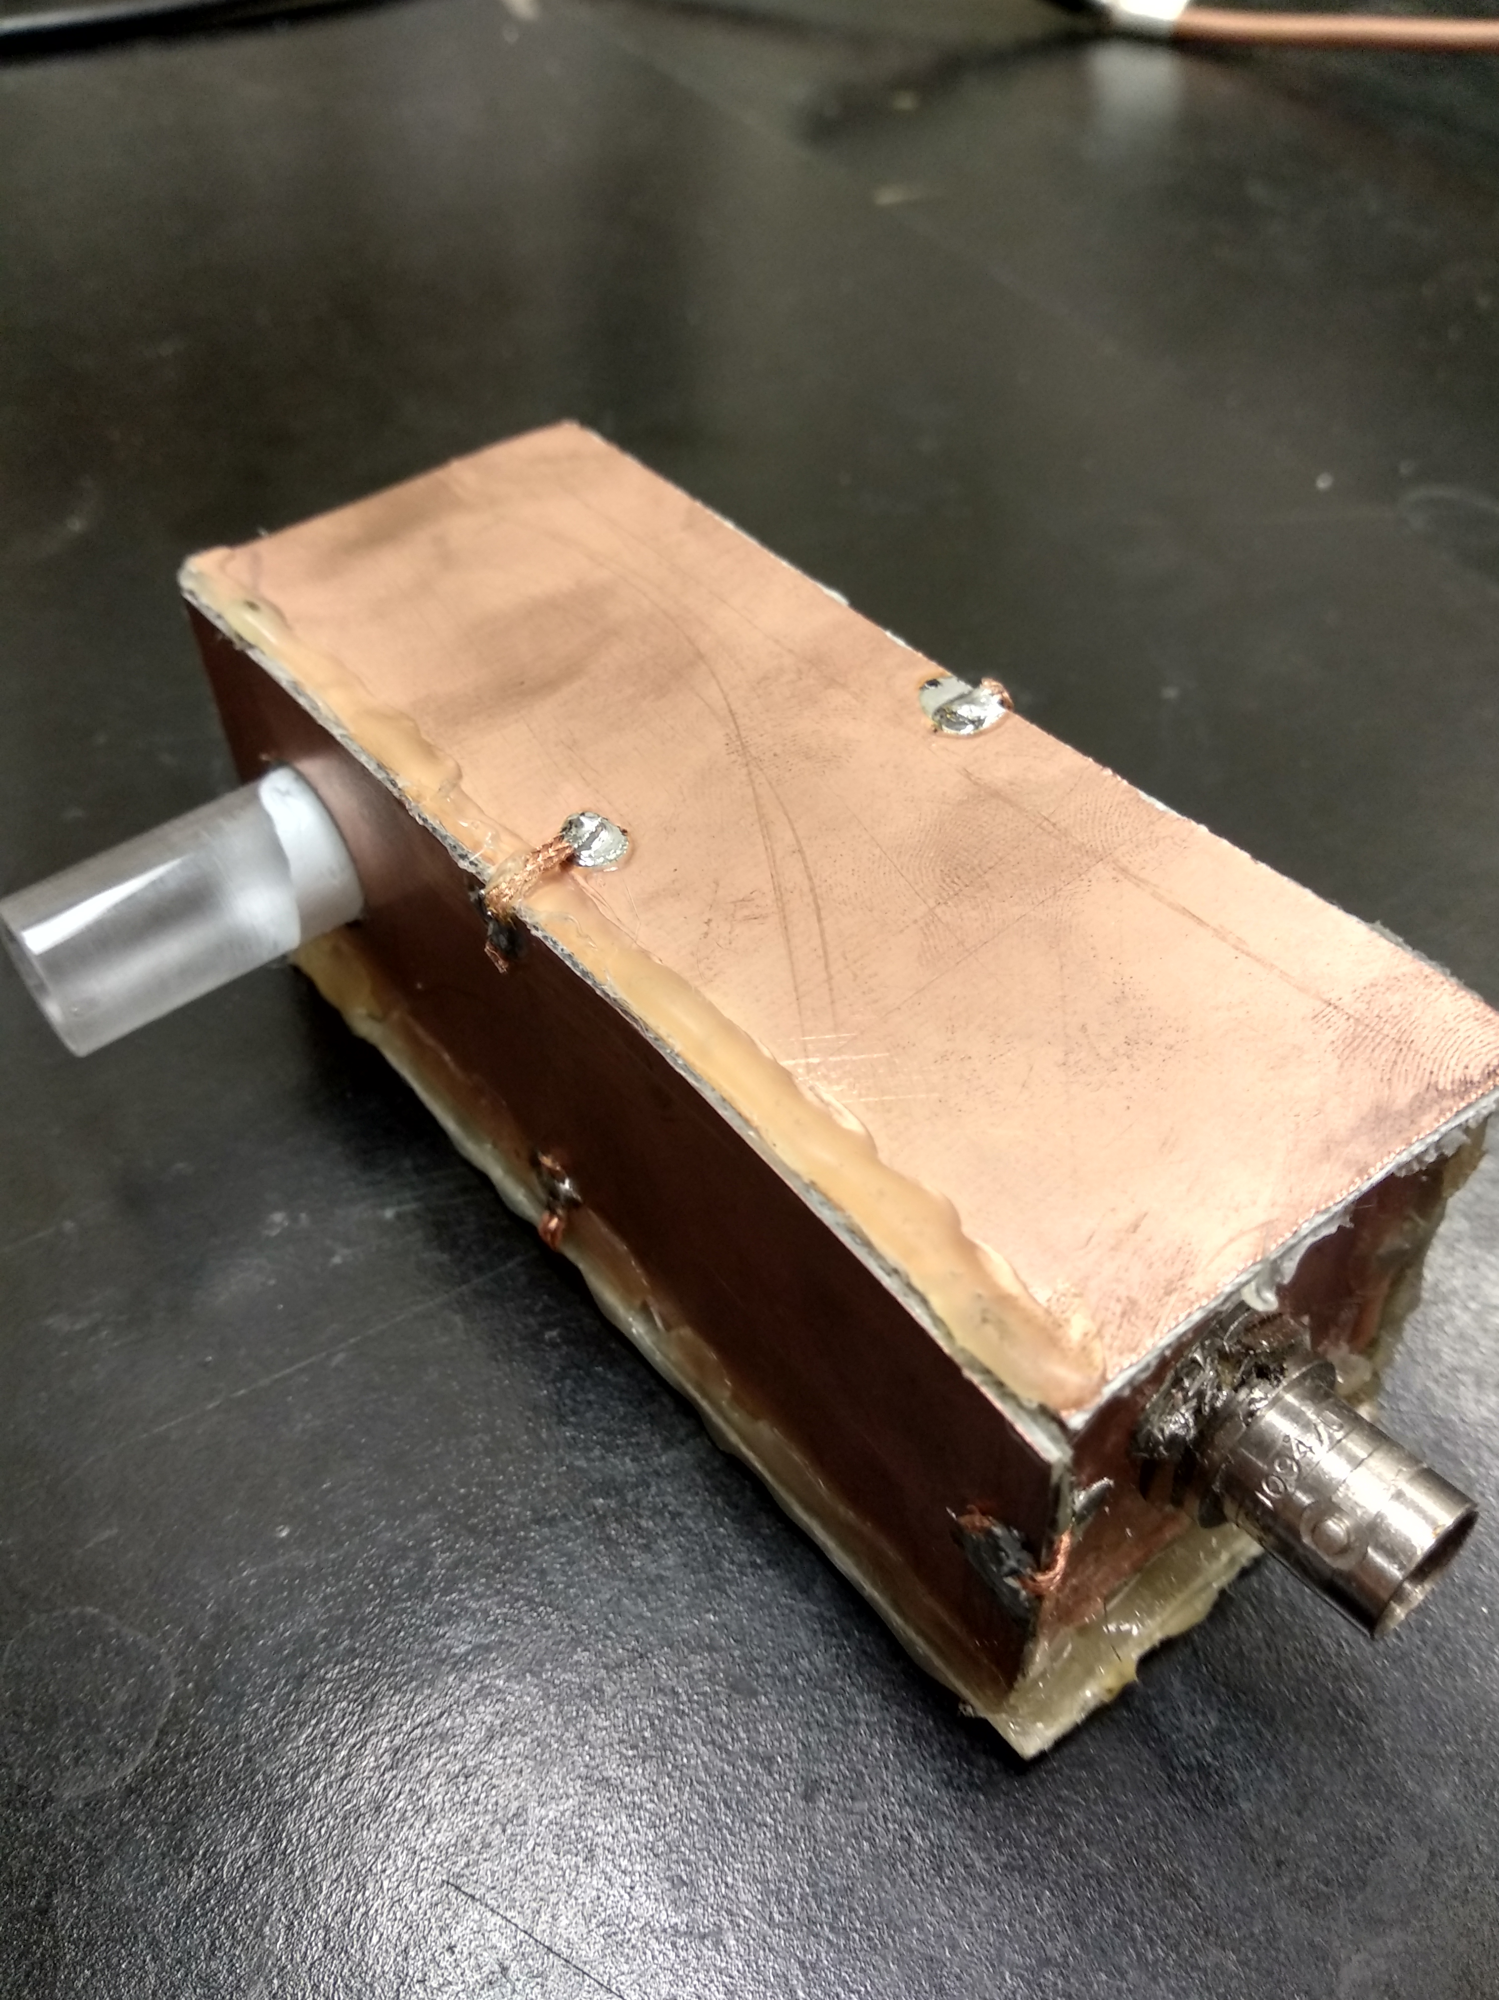
Probe at 2.26MHz
-Attempted to build an inductively matched probe as it had worked for the probe on the GARfield setup.
-Lowest frequency achieved was ~8MHz. To go lower required an inductor in series with the coil, which destroyed matching entirely.
-Overcame problems with capacitevly matched probe by decreasing the Q factor to 20 to decrease ringdown.
-Changing attenuation to match the voltage peak to peak of the probe built for the GARfield magnet.
-Approximating the pulse width

Slide 9
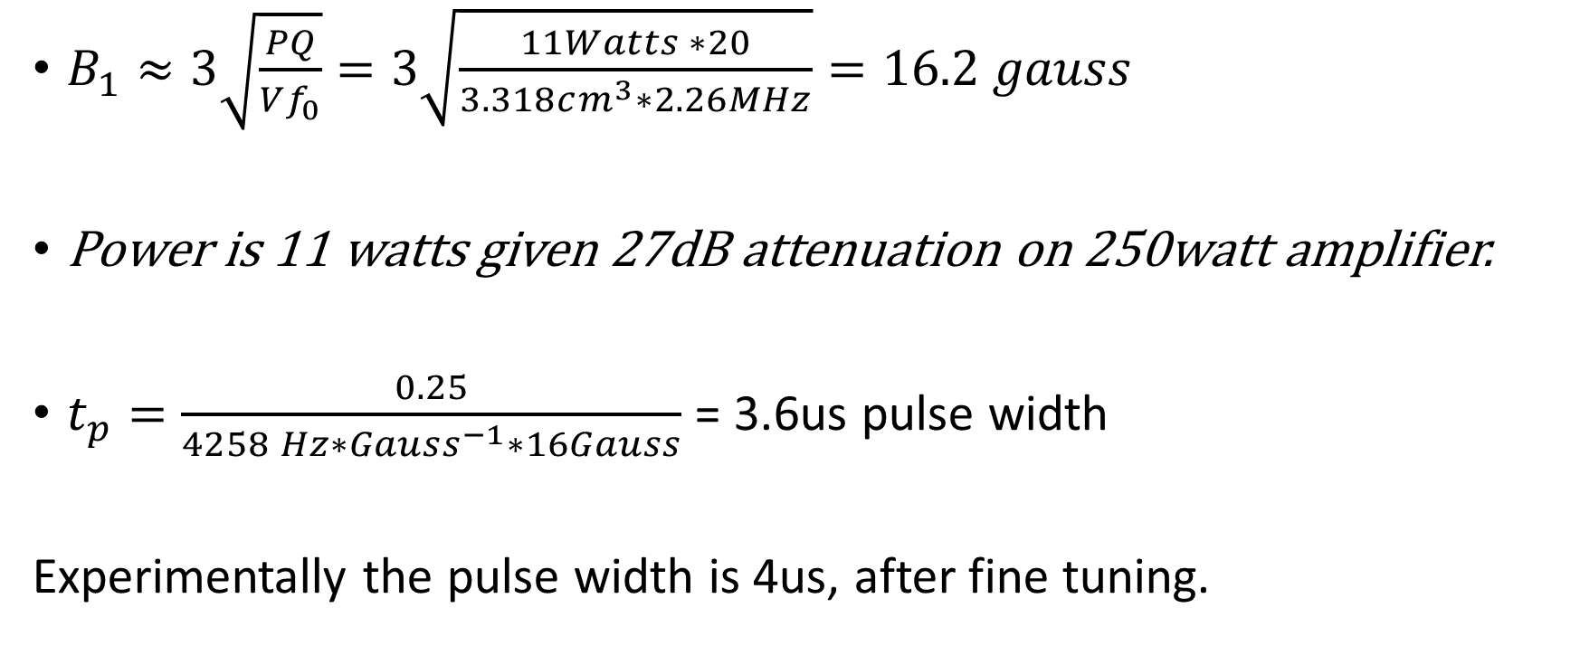
Approximation of Pulse Width
$B_{1}≈3\sqrt{\frac{PQ}{Vf_{0}}}=3\sqrt{\frac{11Watts ∗20}{3.318cm^{3}∗2.26MHz}}=16.2 gauss$
Power is 11 watts given 27dB attenuation on 250watt amplifier.
$t_{p}=\frac{0.25}{4258 Hz∗Gauss^{−1}∗16Gauss}$ = 3.6us pulse width
Experimentally the pulse width is 4us, after fine tuning.

Slide 10
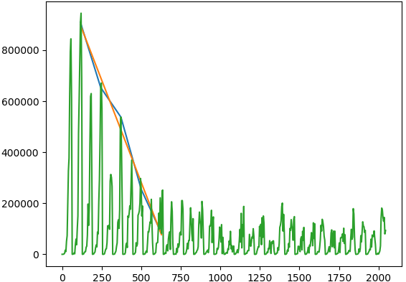
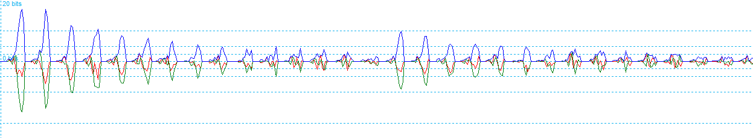
Results of the Setup
200CCM Flow CPMG with SA3 at 10 degrees
Have been able to get signal with alternating peaks that indicates fluid flow.
Alternating peaks change to be a regular exponential decay when the magnet is not at an angle.
More problems to figure out
Magnitude (arbitrary)
Time(us)

Slide 11
Thank you
I want to say thank you for all the help I’ve received while working here. Especially to Ben, Andrés, Grant, Bruce and Jace.

